Slide 1
Data Structures and Algorithms CS2002
Graphs

Slide 2
Graphs
(ref chapter16 of textbook)
A graph G = (V,E) is composed of:
V: set of vertices
E: set of edges connecting the vertices in V
An edge e = (u,v) is a pair of vertices
Example:
a
b
V= {a,b,c,d,e}
E= {(a,b),(a,c),(a,d),
(b,e),(c,d),(c,e),
(d,e)}
c
d
e

Slide 3
Applications
electronic circuits
networks (roads, flights, communications)
CS210
JFK
LAX
LAX
STL
HNL
DFW
FTL

Slide 4
Terminology:
Adjacent and Incident
If (v0, v1) is an edge in an undirected graph,
  v0 and v1 are adjacent
  The edge (v0, v1) is incident on vertices v0 and v1
If <v0, v1> is an edge in a directed graph
  v0 is adjacent to v1, and v1 is adjacent from v0
  The edge <v0, v1> is incident on v0 and v1

Slide 5
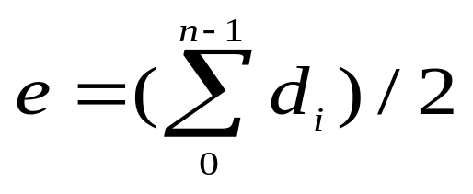

Terminology:
Degree of a Vertex
The degree of a vertex is the number of edges incident to that vertex
For directed graph,
  the in-degree of a vertex v is the number of edges
  that have v as the head
  the out-degree of a vertex v is the number of edges
  that have v as the tail
  if di is the degree of a vertex i in a graph G with n vertices and e edges, the number of edges is
Why? Since adjacent vertices each
count the adjoining edge, it will be
counted twice

Slide 6
Examples
0
3
2
0
1
2
3
3
3
1
2
3
3
4
5
6
G1
1
1
1
3
G2
1
3
0
in:1, out: 1
directed graph
in-degree
out-degree
1
in: 1, out: 2
2
in: 1, out: 0
G3

Slide 7
Terminology:
Path
path: sequence of vertices v₁,v₂,. . .v_{k} such that consecutive vertices v_{i} and v_{i+1} are adjacent.
3
2
3
3
3
a
b
a
b
c
c
d
e
d
e
a b e d c
b e d c

Slide 8
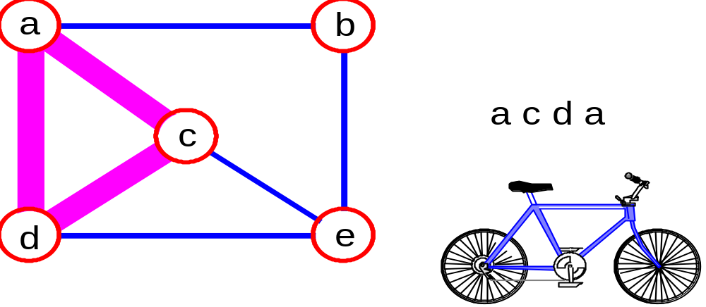
More Terminology
simple path: no repeated vertices
cycle: simple path, except that the last vertex is the same as the first vertex
a
b
b e c
c
d
e

Slide 9
Even More Terminology
connected graph: any two vertices are connected by some path
connected
not connected

Slide 10
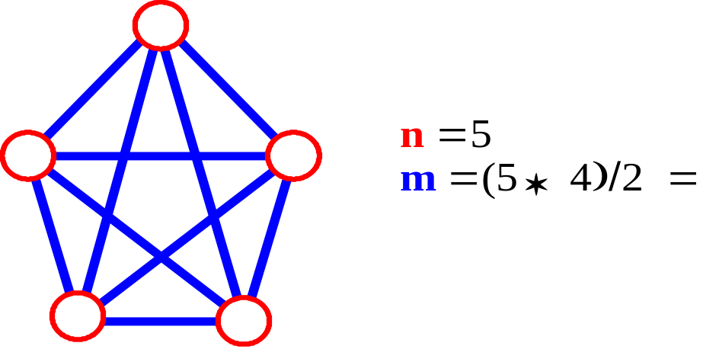
Connectivity
Let n = #vertices, and m = #edges
A complete graph: one in which all pairs of vertices are adjacent
How many total edges in a complete graph?
  Each of the n vertices is incident to n-1 edges, however, we would have counted each edge twice! Therefore, intuitively, m = n(n -1)/2.
Therefore, if a graph is not complete, m < n(n -1)/2

Slide 11
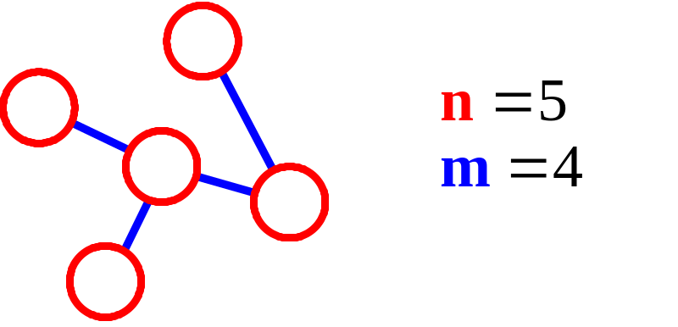
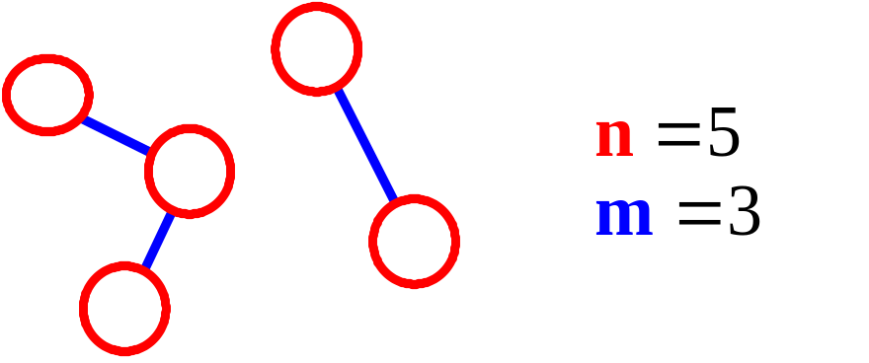
More Connectivity
n = #vertices
m = #edges
For a tree m = n - 1
If m < n - 1, G is not connected

Slide 12
Oriented (Directed) Graph
A graph where edges are directed

Slide 13
Directed vs. Undirected Graph
An undirected graph is one in which the pair of vertices in a edge is unordered, (v0, v1) = (v1,v0)
A directed graph is one in which each edge is a directed pair of vertices, <v0, v1> != <v1,v0>
tail
head

Slide 14
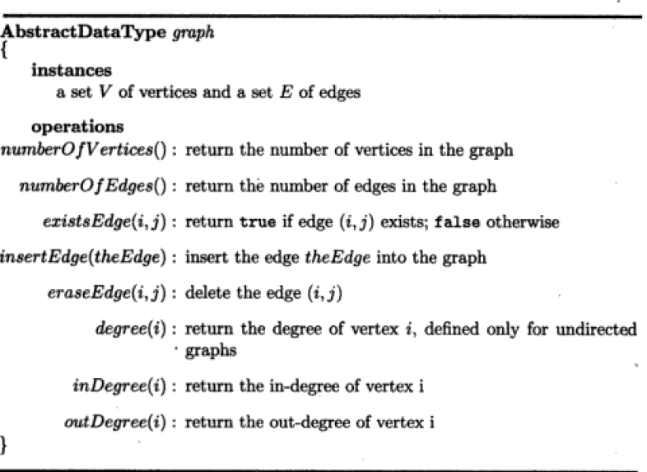
Graph ADT

Slide 15
Graph Representations
Adjacency Matrix
Adjacency Lists

Slide 16
Adjacency Matrix
Let G=(V,E) be a graph with n vertices.
The adjacency matrix of G is a two-dimensional
n by n array, say adj_mat
If the edge (vi, vj) is in E(G), adj_mat[i][j]=1
If there is no such edge in E(G), adj_mat[i][j]=0
The adjacency matrix for an undirected graph is symmetric; the adjacency matrix for a digraph
need not be symmetric

Slide 17
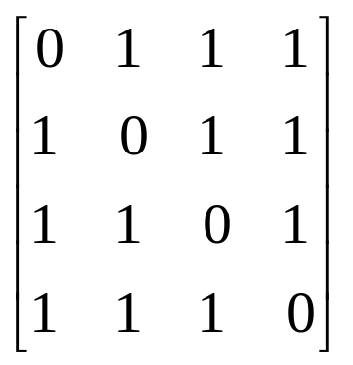
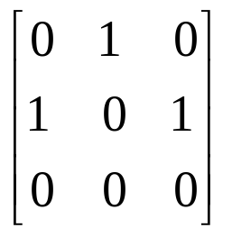
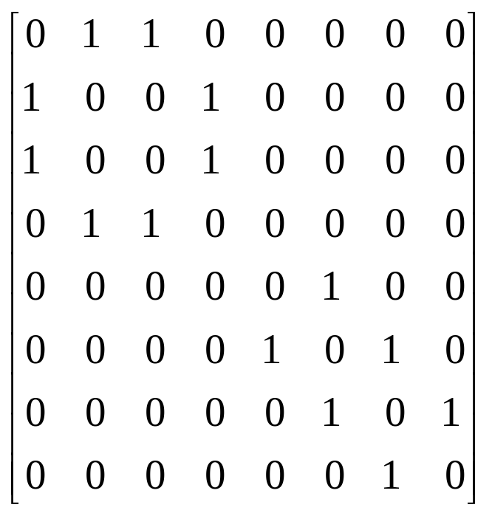
Examples for Adjacency Matrix
0
0
4
0
2
1
5
1
2
3
6
3
1
7
2
G2
G1
symmetric
G4

Slide 18
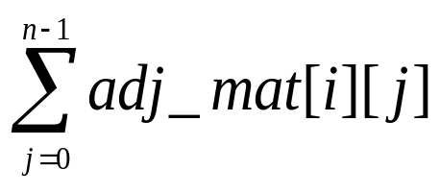
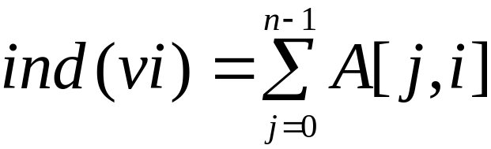
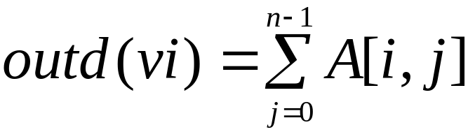
Merits of Adjacency Matrix
From the adjacency matrix, to determine the connection of vertices is easy
The degree of a vertex is
For a digraph (= directed graph), the row sum is the out_degree, while the column sum is the in_degree

Slide 19
Adjacency Lists (data structures)
Each row in adjacency matrix is represented as an adjacency list.
#define MAX_VERTICES 50
class node {
int vertex;
node *link;
};
node *node_pointer;
node_pointer graph[MAX_VERTICES];
int n=0; /* vertices currently in use */

Slide 20
0
0
4
2
1
5
1
2
3
6
3
7
0
1
2
3
1
2
3
0
1
2
3
4
5
6
7
1
2
0
2
3
0
3
0
1
3
0
3
0
1
2
1
2
G1
0
5
4
6
0
1
2
1
5
7
0
2
1
6
G3
G4
2
An undirected graph with n vertices and e edges ==> n head nodes and 2e list nodes

Slide 21
Some Operations
degree of a vertex in an undirected graph
  # of nodes in adjacency list
# of edges in a graph
  determined in O(n+e)
out-degree of a vertex in a directed graph
  # of nodes in its adjacency list
in-degree of a vertex in a directed graph
  traverse the whole data structure

Slide 22
Graph Traversal
Problem: Search for a certain node or traverse all nodes in the graph
Depth First Search
  Once a possible path is found, continue the search until the end of the path
Breadth First Search
  Start several paths at a time, and advance in each one step at a time

Slide 23
Exploring a Labyrinth
Without Getting Lost
A depth-first search (DFS) in an undirected graph G is like wandering in a labyrinth with a string and a can of red paint without getting lost.
We start at vertex s, tying the end of our string to the point and painting s “visited”. Next we label s as our current vertex called u.
Now we travel along an arbitrary edge (u, v).
If edge (u, v) leads us to an already visited vertex v we return to u.
If vertex v is unvisited, we unroll our string and move to v, paint v “visited”, set v as our current vertex, and repeat the previous steps.

Slide 24
Pseudocode for DFS
depthfirstSearch(v)
{
  Label vertex v as reached
  for (each unreached vertex u adjacent from v)
  depthfirstSearch(u)
}

Slide 25
DFS
DFS Process
F
B
A
start
E
G
D
C
destination
C
DFS on C
D
Call DFS on D
B
DFS on B
B
B
Return to call on B
A
DFS on A
A
A
A
G
Call DFS on G
found destination - done!
Path is implicitly stored in DFS recursion
Path is: A, B, D, G
D
B
A

Slide 26
Breadth-First Search
Like DFS, a Breadth-First Search (BFS) traverses a connected component of a graph, and in doing so defines a spanning tree with several useful properties.
The starting vertex s has level 0, and, as in DFS, defines that point as an “anchor.”
In the first round, the string is unrolled the length of one edge, and all of the edges that are only one edge away from the anchor are visited.
These edges are placed into level 1
In the second round, all the new edges that can be reached by unrolling the string 2 edges are visited and placed in level 2.
This continues until every vertex has been assigned a level.
The label of any vertex v corresponds to the length of the shortest path from s to v.

Slide 27
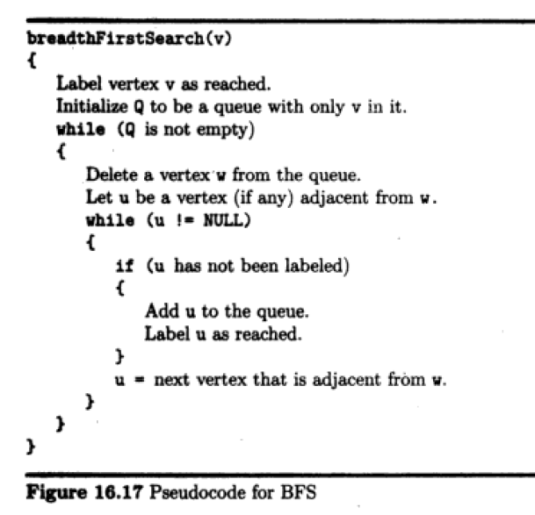

Slide 28
BFS
F
B
A
start
E
BFS Process
G
D
C
destination
rear
front
rear
front
rear
front
rear
front
A
B
D
C
D
Initial call to BFS on A
Add A to queue
Dequeue A
Add B
Dequeue B
Add C, D
Dequeue C
Nothing to add
rear
front
G
found destination - done!
Path must be stored separately
Dequeue D
Add G

Slide 29
Applications: Finding a Path
Find path from source vertex s to destination vertex d
Use graph search starting at s and terminating as soon as we reach d
  Need to remember edges traversed
Use depth – first search ?
Use breath – first search?

Slide 30
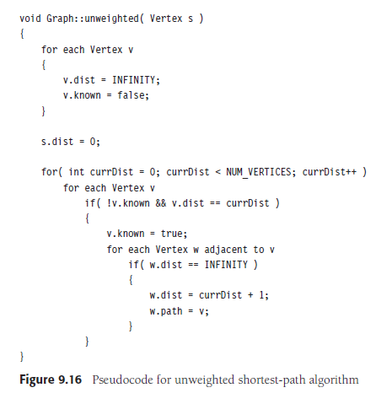
Path finding for unweighted graph using BFS

Slide 31
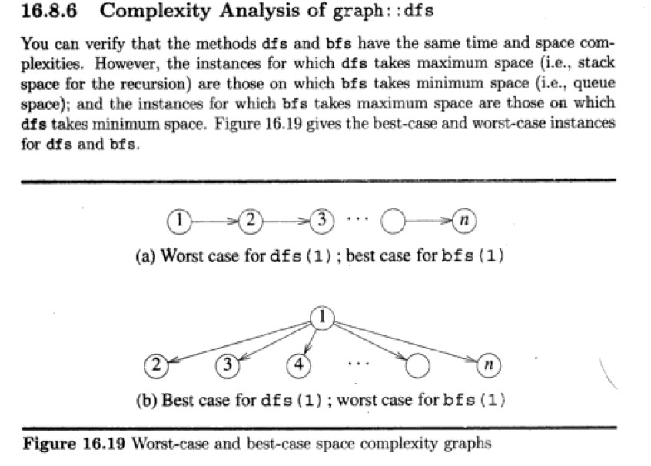


Slide 32
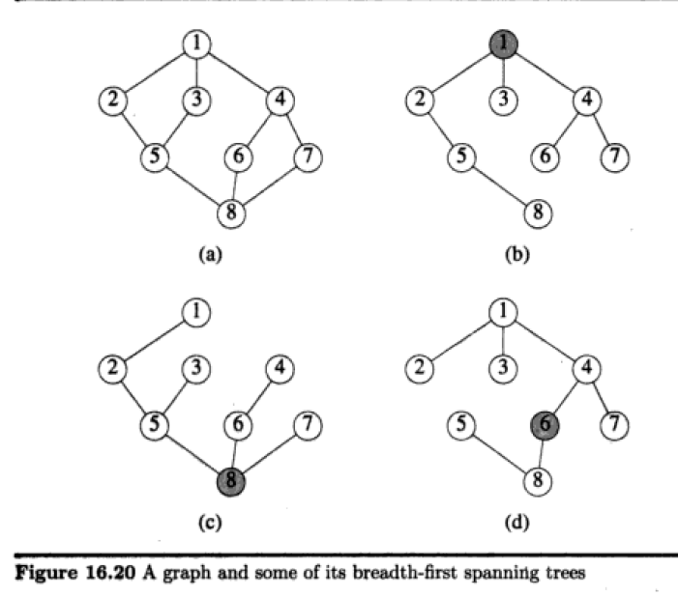
Spanning tree
a spanning tree T of an undirected graph G is a subgraph that is a tree which includes all of the vertices of G, with minimum possible number of edges.

Slide 33
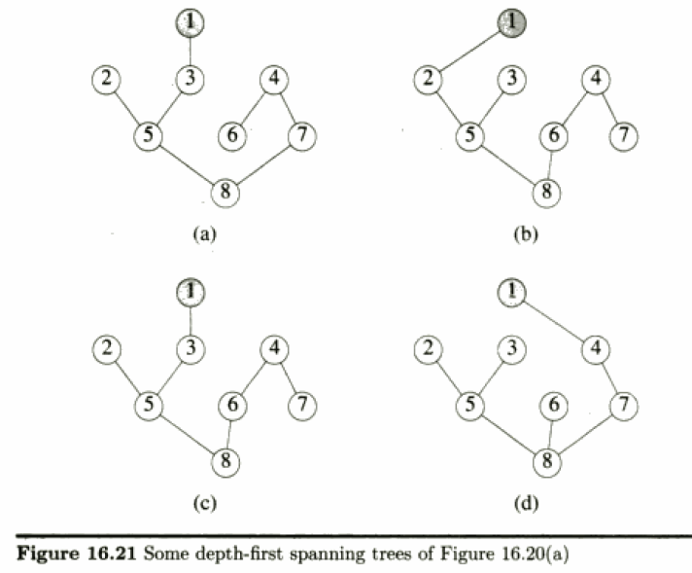

Slide 34
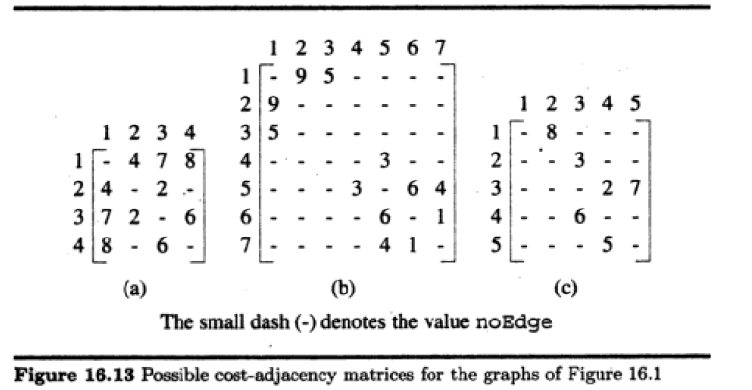
Weighted Graphs
Weighted graphs are represented with schemes that are simple extensions of those used for unweighted graphs

Slide 35
